Slide 1

Predicting the Age of Abalone
Multiple Linear Regression Model
Decision Tree

Slide 2
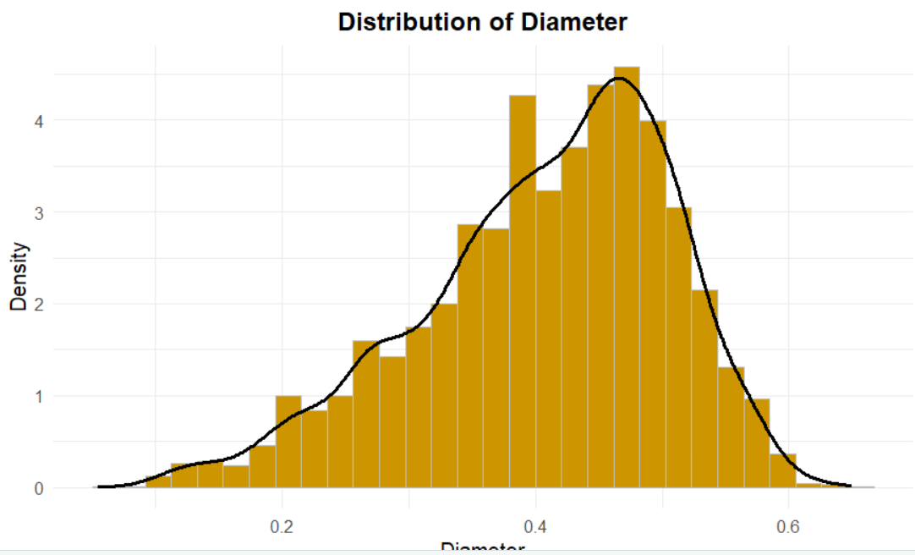
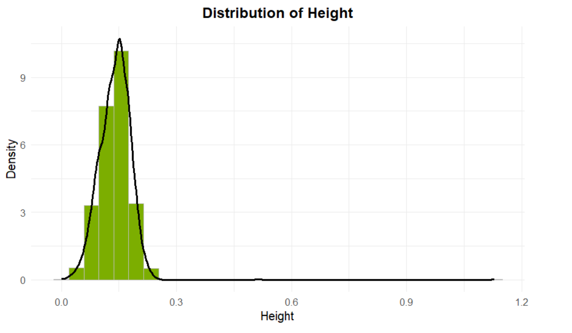
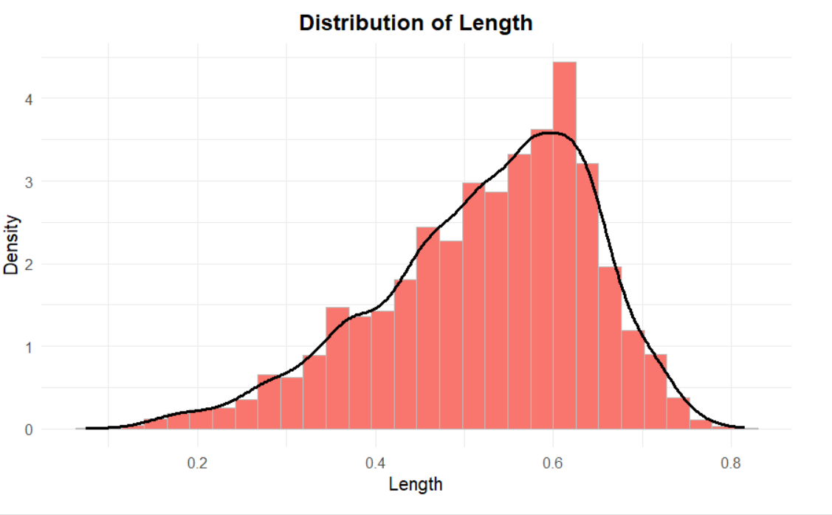
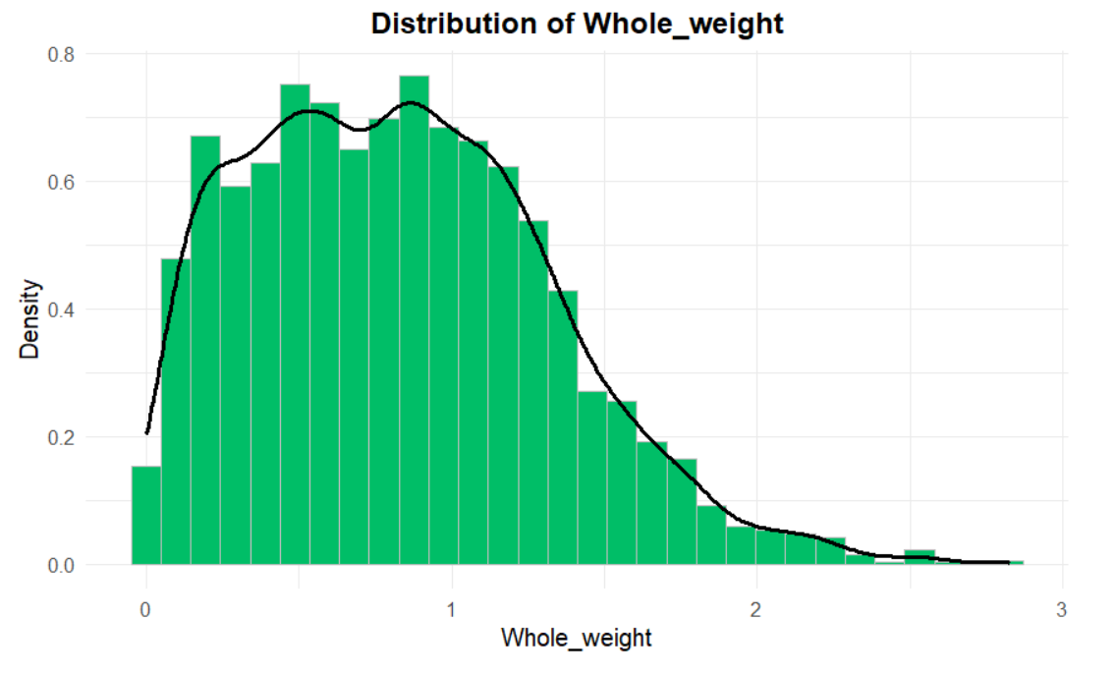
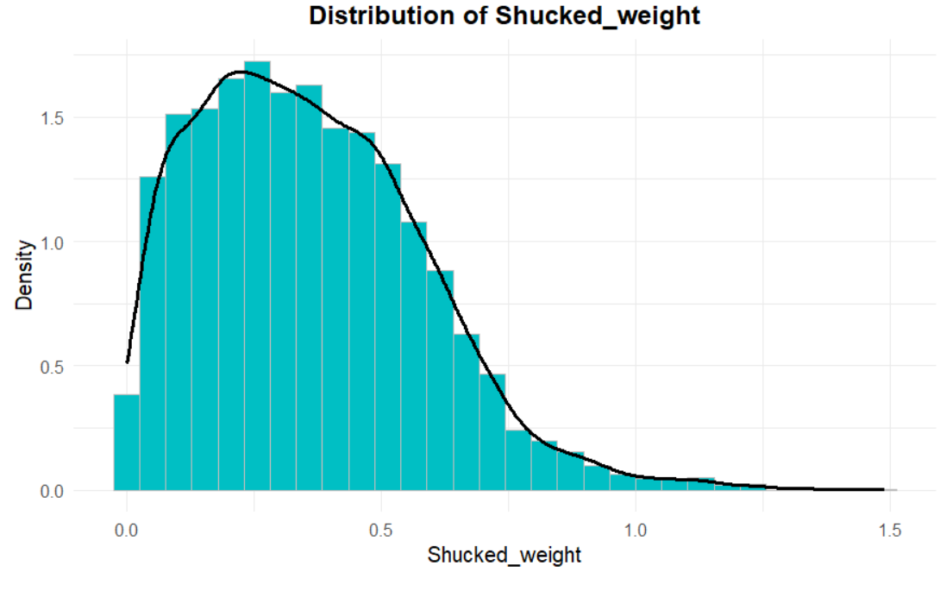
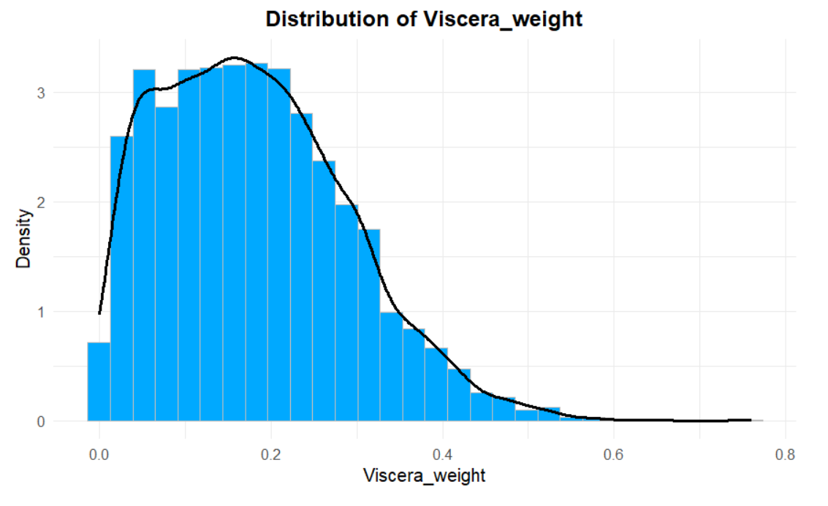
Distribution of Independent Variables(Predictors)

Slide 3
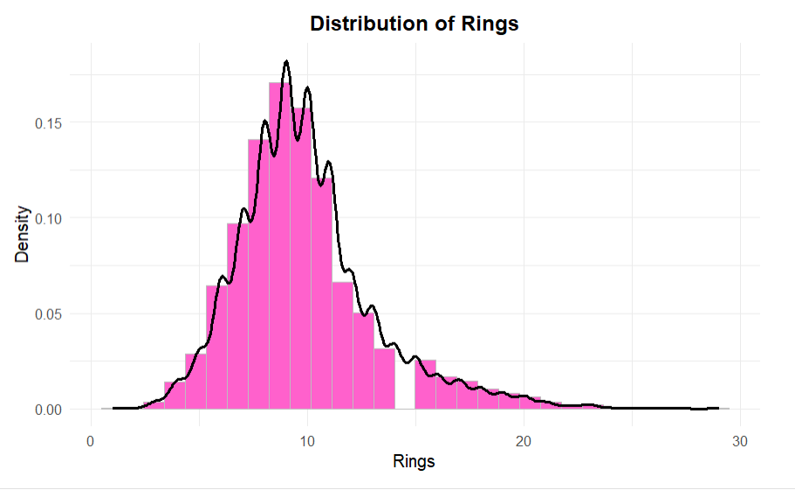
Distribution of Response Variable

Slide 4
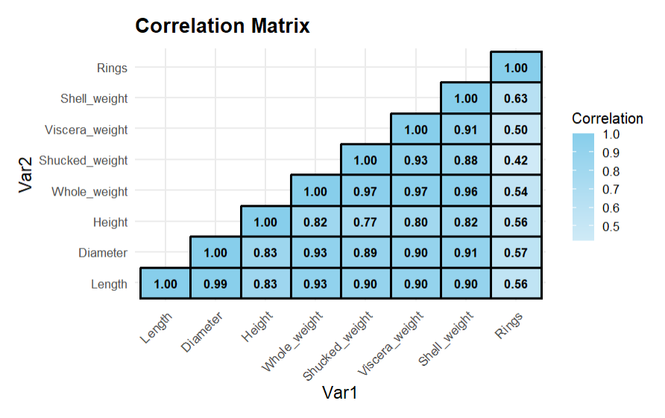
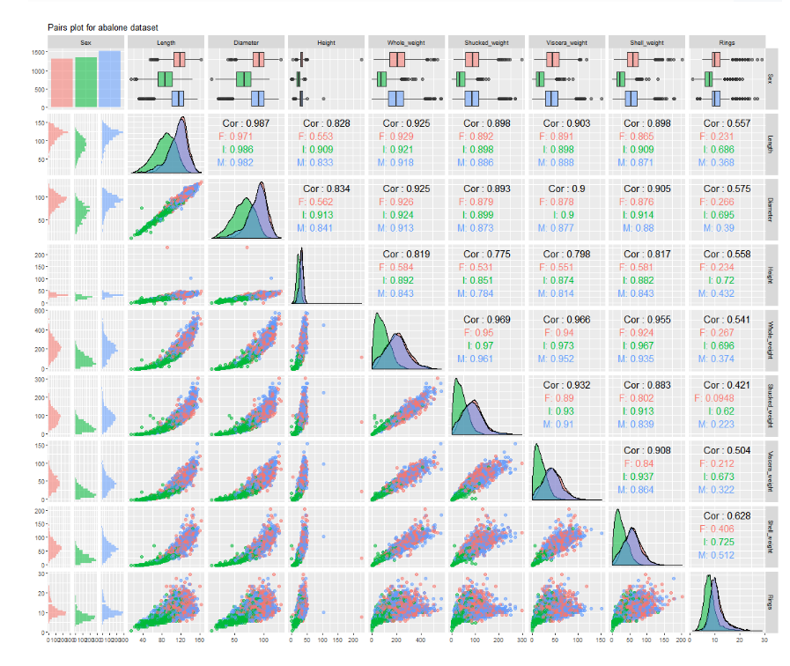
Relationship between the variables

Slide 5
Using Multiple Linear Regression

Slide 6
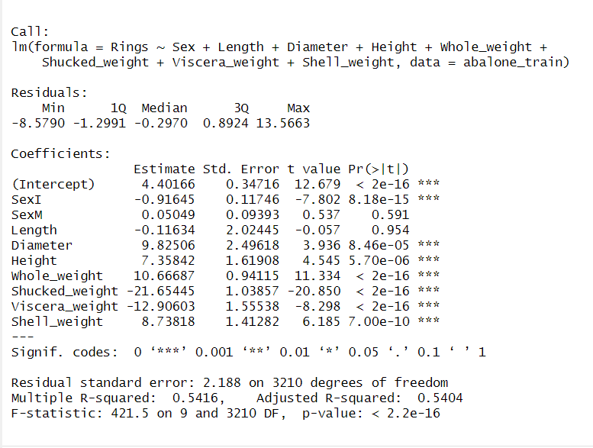
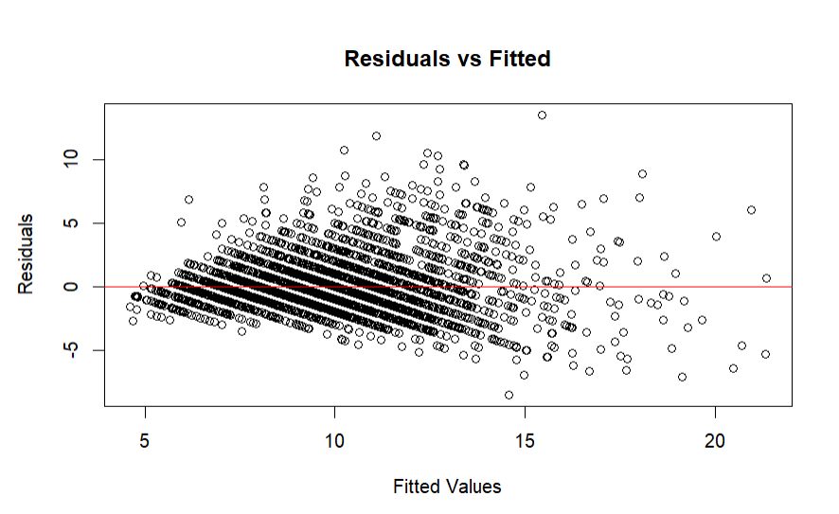
Abalone initial model built with all the predictors
Train RMSE : 2.184365
Test RMSE :2.235367

Slide 7
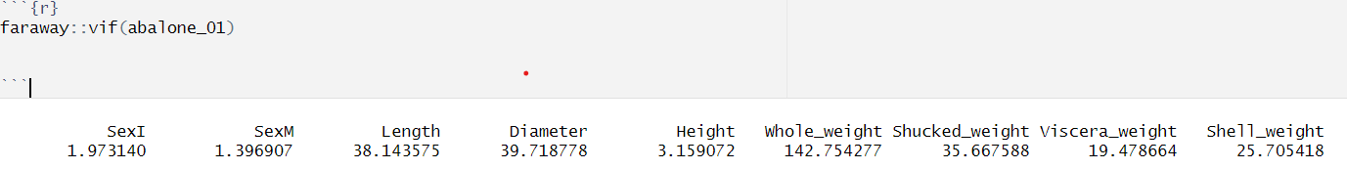
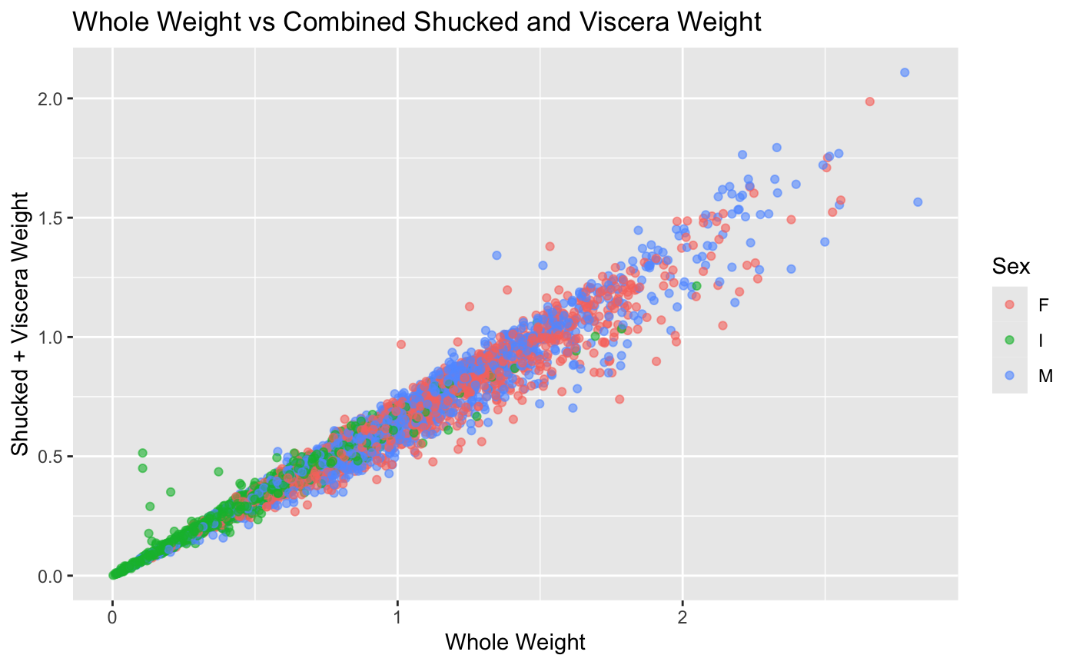
Vif : Initial Model

Slide 8
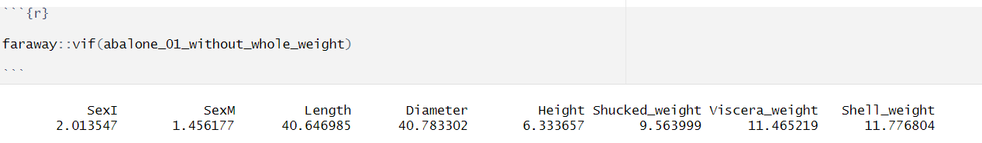
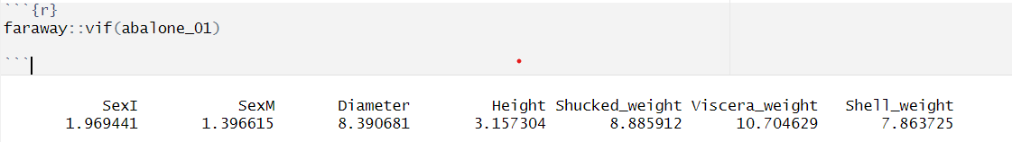
MultiCollinearity
Vif : After removing Whole weight from the model
Vif : After the removal of Length from the model

Slide 9
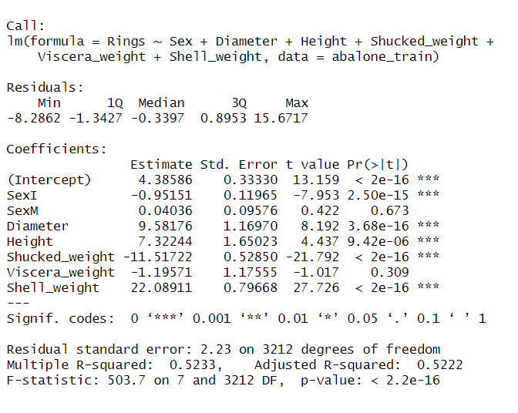
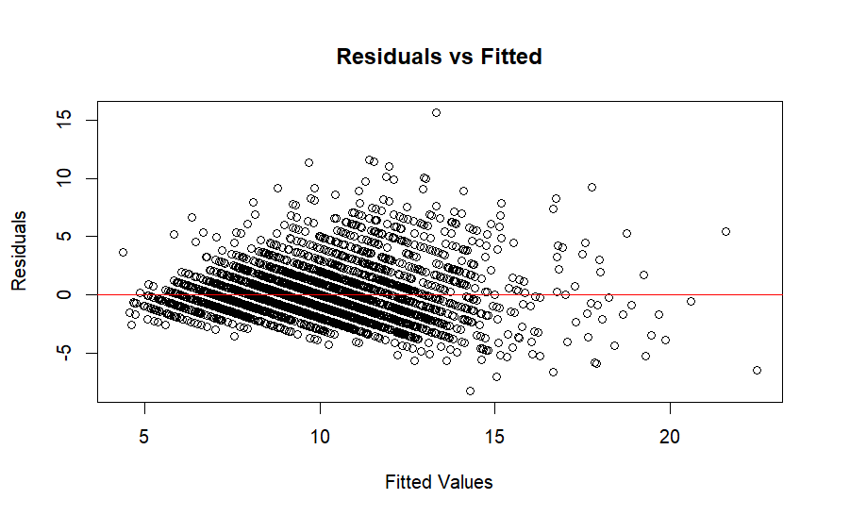
Model Built after removing multicollinear variables
Train RMSE : 2.22771
Test RMSE : 2.304325

Slide 10
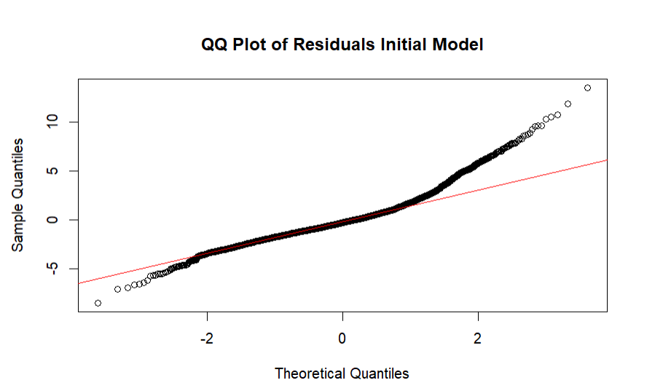
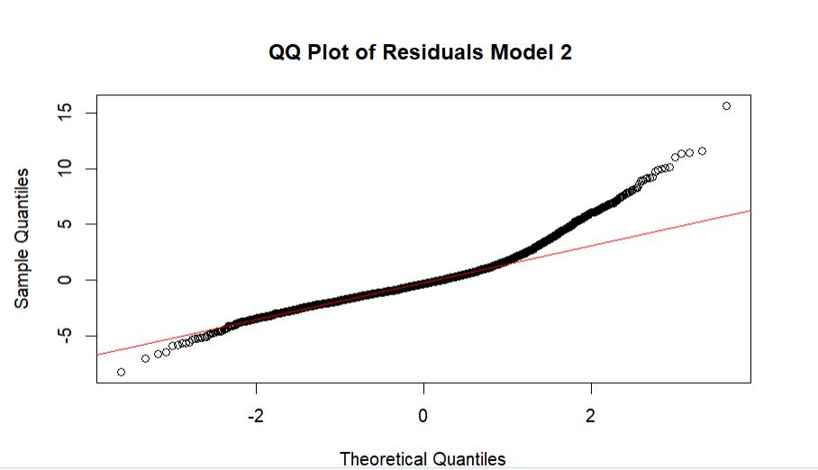

Slide 11
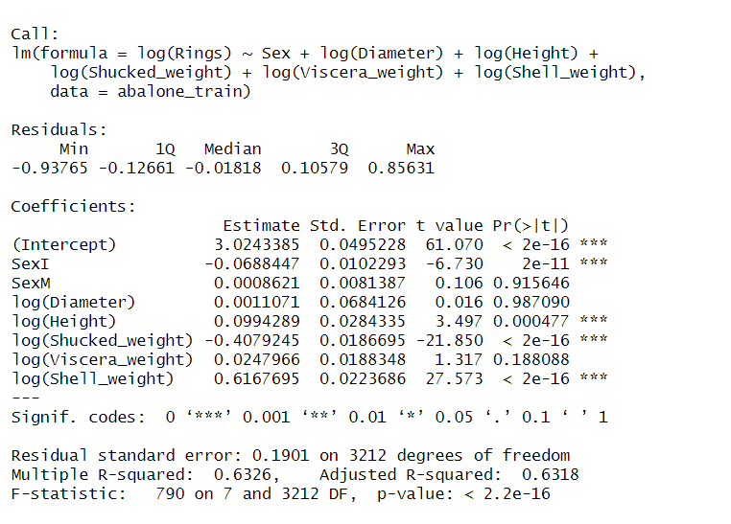
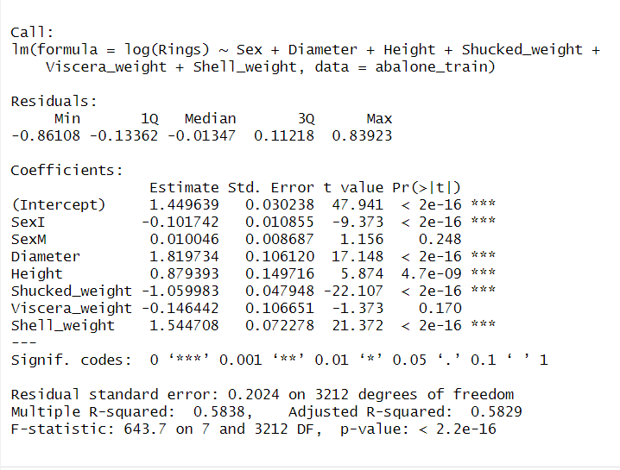
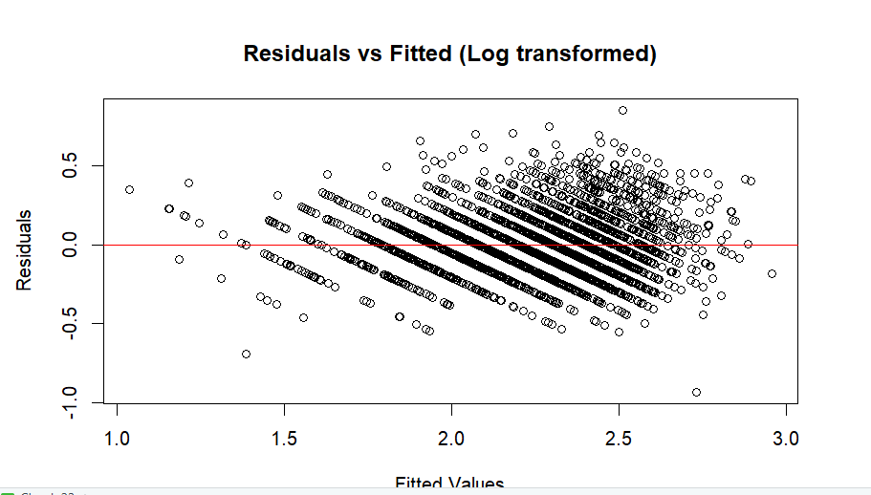
After Applying log transformation to the dependent variable
Train RMSE : 2.294398
Test RMSE : 2.407712

Slide 12
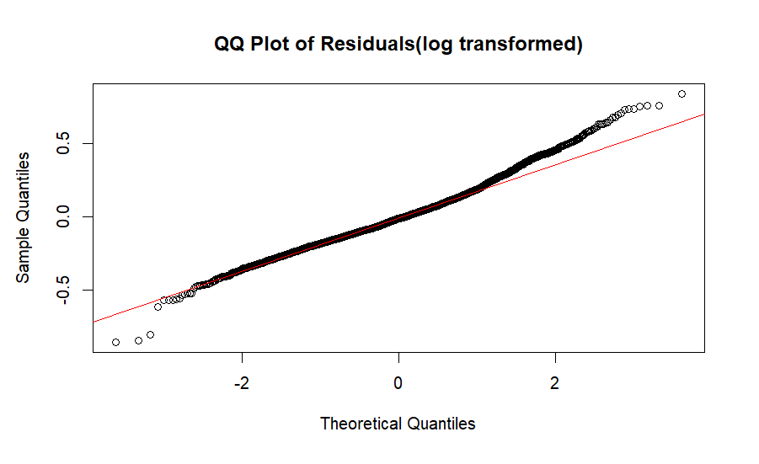
After Log transformation the residuals slightly follows a normal distribution.

Slide 13
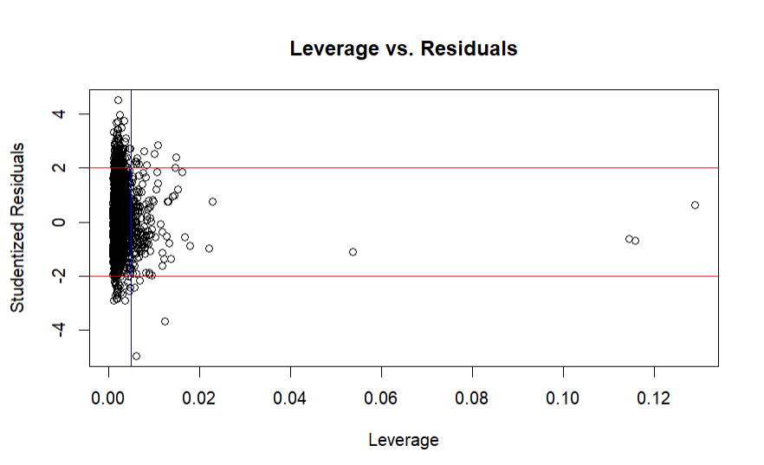
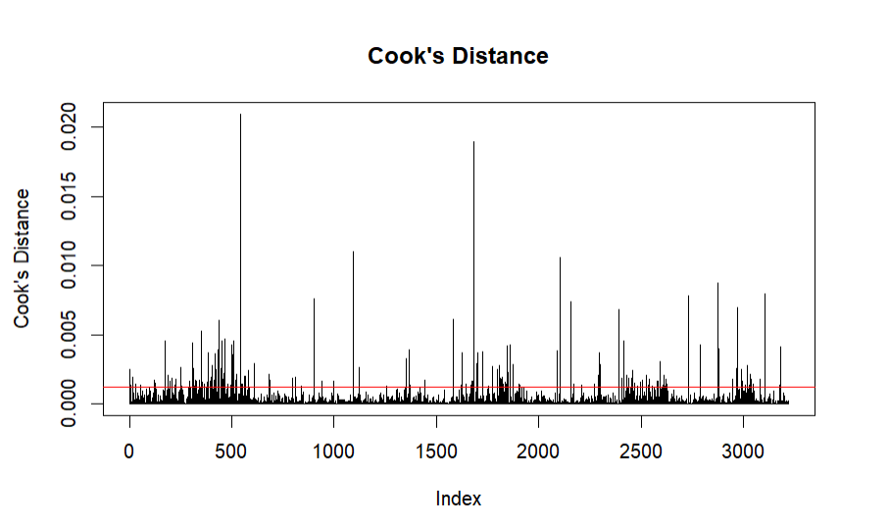
High Influencial Points

Slide 14
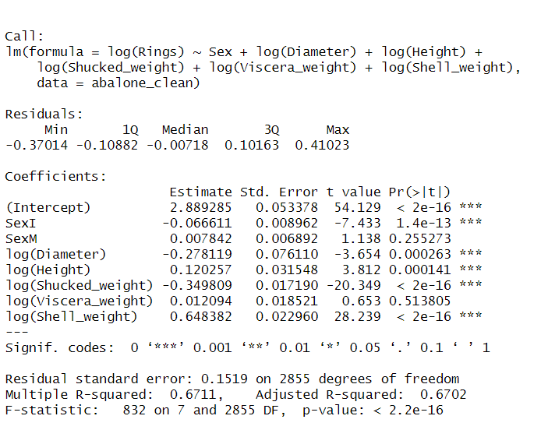
Re-fitting the model after removing the high influence points
Train RMSE :1.59136
Test RMSE : 2.291886

Slide 15
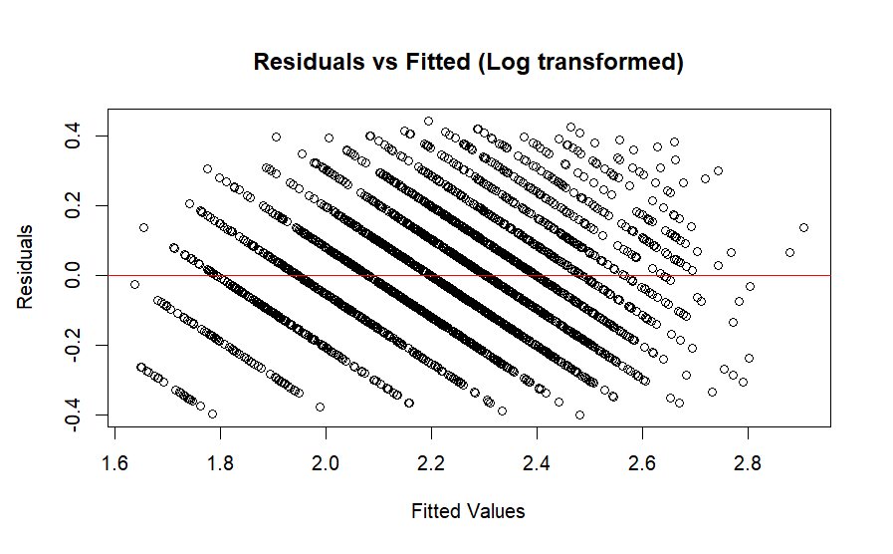
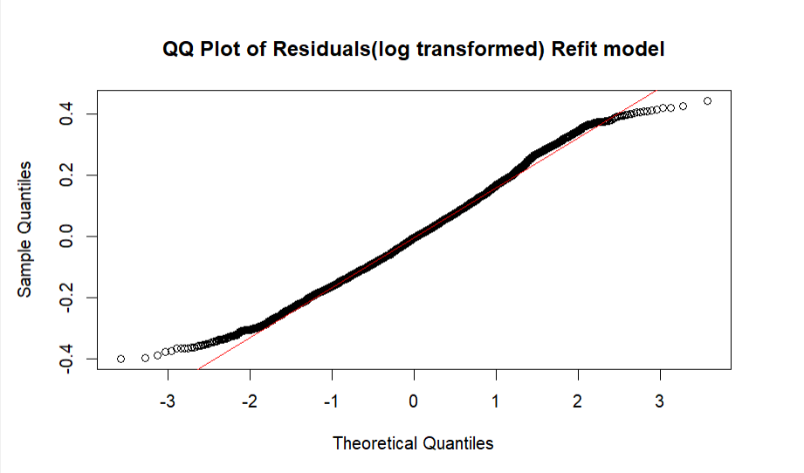

Slide 16
Using Regression Tree

Slide 17
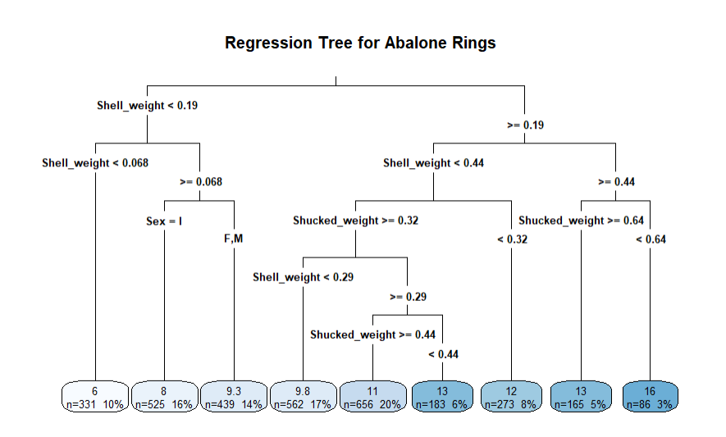
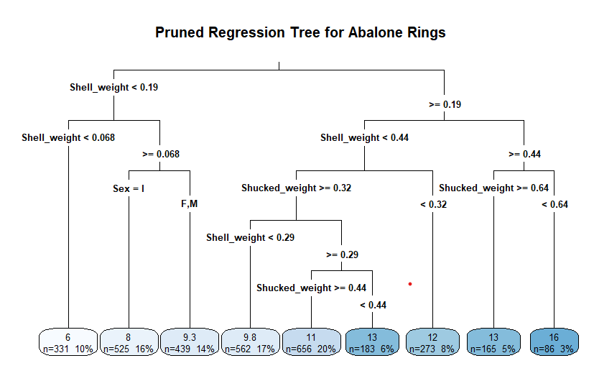
Regression Tree
Train RMSE : 2.3402
Test RMSE : 2.47908
Pruned Regression Tree
Train RMSE :2.3402
Test RMSE : 2.47908

Slide 18
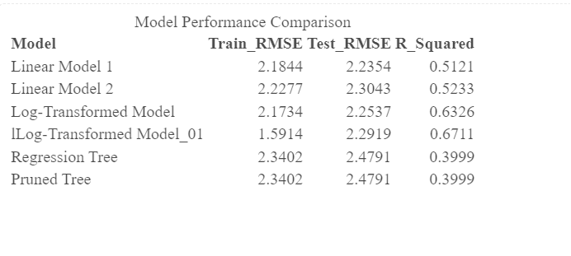
Model Comparison

Slide 19
Conclusion
Log-Transformed Model could be used for more accuracy in explaining variance but risks overfitting
While Linear Model 1 performs reasonably well in terms of RMSE, the multicollinearity can make the model less reliable in real-world applications, especially if you want to understand the impact of individual predictors.
Regression Tree models have higher Test RMSE and lower R^2, indicating poor performance compared to linear models. Pruning didn’t improve the tree, suggesting a fundamental limitation in tree-based methods for this problem.
Linear Model 2 is the better choice. Although it has a slightly higher Test RMSE and lower R^2, the absence of multicollinearity provides a more stable and interpretable model.

